Slide 1
Pandas vs Polars
April 2023

Slide 2
Major differences

Slide 3
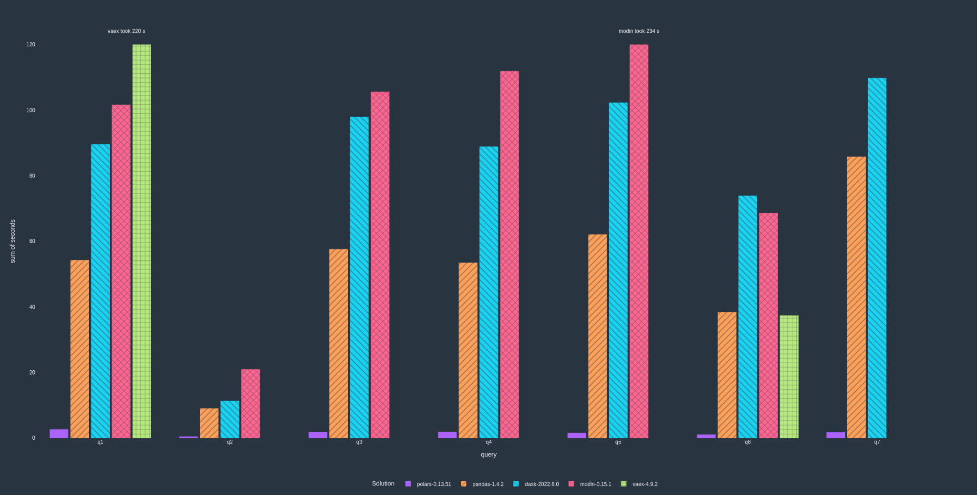
Time Comparison
Read of Parquet file

Slide 4


Code example
Mantu is an independent global player providing guidance and services to businesses and entrepreneurs.
Mantu is made of an ecosystem of different brands (see next slide).
Amaris Consulting is a Brand of Mantu ecosystem, part of the technology practice.
Regardless of their expertise or the sector they operate in, all the brands share a single mission: build and nurture a talent community to achieve businesses and entrepreneurs’ ambitions.

Slide 5
Reference List
Pandas Doc: https://pandas.pydata.org/docs/
Polars Doc: https://www.pola.rs/
Polars User Guide: https://pola-rs.github.io/polars-book/user-guide/

